Slide 1
CSC 177 Presentation
Isabel Santoyo-Garcia & Marilyn Sarabia

Slide 2
Data Preprocessing Project
With the titanic.csv Dataset

Slide 3
Data Preprocessing Project
We worked on the Titanic dataset to predict many factors such as:
Whether a passenger survive.
Passenger demographic analysis.
Classification.
Fare prediction.
Identified missing values in columns such as Age, Cabin, and Embarked.
For numerical columns like Age and Fare, missing values were replaced with the median to retain the central tendencies of the data.
We used the most frequent value for categorical columns like Embarked to fill in missing entries.
Outliers were visualized using box plots and histograms, particularly in columns like Age and Fare.
These visualizations highlighted extreme values (ex: very high fares or very young/old passengers).
Outliers were not removed since they provide valuable information about passenger demographics.

Slide 4
Data Preprocessing Project
Handling missing values:
Replaced missing values in Age and Fare with the median to avoid skewing the data toward outliers.
Filled missing values in the Embarked column with the most frequent value to keep it consistent.
The Cabin column was dropped due to a large amount of missing data over 80%.
Would introduce too much uncertainty.
Encoding categorical variables:
Convert Sex and Embarked columns into numerical values using one-hot encoding.

Slide 5
Data Preprocessing Project
Steps
Load the data and identify missing values.
Handle missing values: median for numerical columns (Age, Fare) and mode for categorical columns (Embarked).
Drop the Cabin column due to too many missing values.
Encode categorical features like Sex and Embarked using one-hot encoding.
Apply normalization to numerical features like Age and Fare.
Discretize key features like Age into bins for category-based analysis.
Aggregate data such as Fare for grouped insights.
Apply feature selection techniques like Information Gain, Chi-Square Test, and Variance Threshold to reduce the dataset to relevant variables.

Slide 6
Classification Models Project
With the titanic.csv Dataset

Slide 7
Classification Models Project
Decision Tree Regressor for Continuous Data
The Decision Tree Regressor was applied to predict the ‘fare’ based on continuous features, specifically ‘pclass’ and ‘age’
Steps & Results
Selected ‘pclass’ and ‘age’ as predictor variables and ‘fare’ as the target.
Trained a DecisionTreeRegressor on the training dataset to predict ‘fare’.
Visualized predictions by plotting ‘age’ against ‘fare’, using constant values for ‘pclass’.

Slide 8
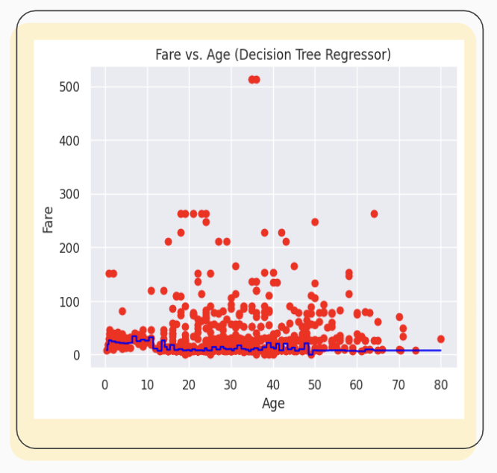
Classification Models Project
The plot showed the actual fare versus the age values, indicating a weak relationship, therefore age does not have a strong influence on fare, as the Decision Tree Regressor line appears mostly flat and close to zero, and remains relatively constant across all age values.

Slide 9
Classification Models Project
Decision Tree Classifier for Categorical Data
The Decision Tree Classifier was used to classify passengers as either ‘survived’ or ‘not survived’.
We worked to predict categorical outcomes based on selected passenger attributes.
Steps & Results
Selected ‘pclass’, ‘age’, ‘fare’, and ‘sibSp’ as features and ‘survived’ as the target.
Trained a DecisionTreeClassifier with entropy as the splitting criterion and a maximum tree depth of 3 to avoid overfitting.
Predicted survival status for new passenger data.
analyzed the accuracy.

Slide 10
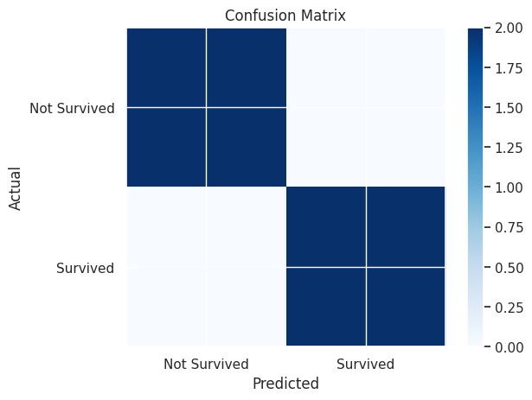
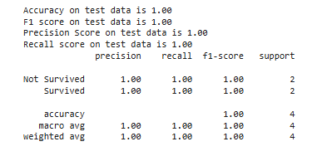
Classification Models Project
Performance
Used confusion matrix to visually display the model accuracy through metrics of: precision, recall, and F1 score.
The ‘not survived’ class was 1.0, indicating the model was highly effective at identifying passengers who did not survive.
C.
All metrics are 1.00 for both classes ("Not Survived" and "Survived"), indicating perfect precision, recall, and F1-score.

Slide 11
Classification Models Project
Feature Selection
We chose 'pclass,' 'age,' 'fare,' 'sibsp,' and 'sex' (binary-encoded) as variables, ensuring relevant, cleaned data.
Data Splitting
A 70-30 train-test split was applied with cross-validation to avoid overfitting and ensure consistent data processing.
Running Classification Models
We trained each classification model using selected features and validated on the test set.
Utilized classification techniques like decision tree, logistic regression, naive bayes, support vector machine (SVM), K-nearest neighbor (KNN), and artificial neural network (ANN).

Slide 12
Classification Models Project
Running Classification Models
Decision Tree: Used entropy as the criterion and limited tree depth to prevent overfitting.
Logistic Regression: Tuned C values to identify the best fit.
Result: Good accuracy and interpretability as a linear model.
Naive Bayes: Implemented Gaussian Naive Bayes, considering continuous features like 'fare' and 'age.'
Result: Reasonable accuracy but limited by the assumption of feature independence (not fully valid for Titanic).
Support Vector Machine (SVM): Tested linear and RBF kernels, adjusting the C parameter to optimize performance.
Result: Performed well.
K-nearest neighbor (KNN): Experimented with different values of K.
Result: Performed moderately well.
Artificial Neural Network (ANN): Built and trained a neural network.
Result: Achieved high accuracy after 100 epochs.
Outcome
The ANN and SVM models with an RBF kernel outperformed other models in terms of accuracy.

Slide 13
Cluster Analysis, ANN and Text Mining Project
With the imdb_dataset.csv Dataset

Slide 14
Cluster Analysis, ANN and Text Mining Project
Cluster Analysis
The project focused on K-means clustering and hierarchical clustering on the IMDb dataset to discover patterns among movie attributes like runtime, rating, and audience score.
K-Means Clustering
K-Means organizes data into groups where items in the same group are more similar.
Feature Selection: Selected numeric features ‘runtime,’ ‘imdb_rating,’ and ‘audience_score’ for clustering.
Non-numeric attributes (‘title’ and ‘genre’) were excluded.
Applied K-Means with k=2 clusters.
Results
Cluster 0: Movies with higher audience scores and IMDb ratings.
Cluster 1: Movies with lower audience scores and shorter runtimes.

Slide 15
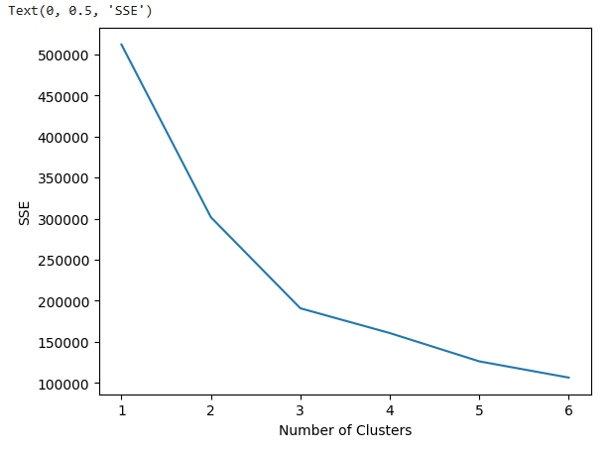
Cluster Analysis, ANN and Text Mining Project
Determining the number of clusters in the data
We applied K-Means with 1 to 6 clusters and computed the corresponding sum-of-squared errors (SSE). The "elbow" in the SSE plot was used to estimate the optimal number of clusters.
The SSE plot showed an "elbow" at k=2, confirming this as the ideal number of clusters

Slide 16
Cluster Analysis, ANN and Text Mining Project
Hierarchical Clustering
Hierarchical clustering builds a hierarchy of clusters using a distance matrix.
Linkage Methods
Single linkage (MIN), complete linkage (MAX), and group average.
Feature Selection
Used the same numeric features as K-Means: ‘runtime,’ ‘imdb_rating,’ and ‘audience_score.’
Dendrograms
Visualized the clustering process, revealing clusters of movies grouped by similarity.

Slide 17
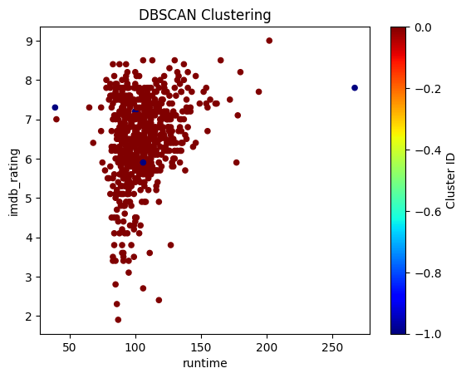
Cluster Analysis, ANN and Text Mining Project
Density-Based Clustering
Grouping
Movies were grouped based on ‘runtime’ and ‘imdb_rating.’
Progress
Applied DBScan with a neighborhood radius (eps) of 15.5 and minimum points (min_samples) of 5. Clusters were assigned IDs from 0 to 8, with noise points assigned a cluster ID of -1.
Results
The scatterplot identified noise points (cluster ID -1), representing outliers, or movies that do not fit within a cluster.

Slide 18
Cluster Analysis, ANN and Text Mining Project
ANN
Implemented ANN by splitting the dataset into training and testing sets using train_test_split, ensuring separate sets for each run.
Target variable
‘audience_rating’ (categorical values Upright and Spilled) converted to numerical (binary) for use in ANN and other models like Logistic Regression and Decision Tree Classifier.
Comparison with Other Classification Models
ANN
Average accuracy ~63%, correctly predicting ‘audience_rating‘ 63% of the time on test data.
Logistic Regression
Average accuracy ~67%, correctly predicting ‘audience_rating’ 67% of the time, performing slightly better than ANN.
Decision Tree Classifier
Average accuracy ~65%, correctly predicting the target variable 65% of the time.

Slide 19
Linear Regression Project
With the titanic.csv Dataset

Slide 20
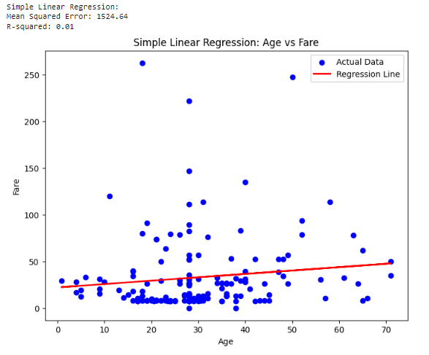
Linear Regression Project
Simple Linear Regression: Age vs. Fare
MSE of 1524.64 shows poor model fit, with ‘fare’ poorly predicted by ‘age.’ R-squared of 0.01 confirms ‘age’ is a weak predictor, capturing little relationship.

Slide 21
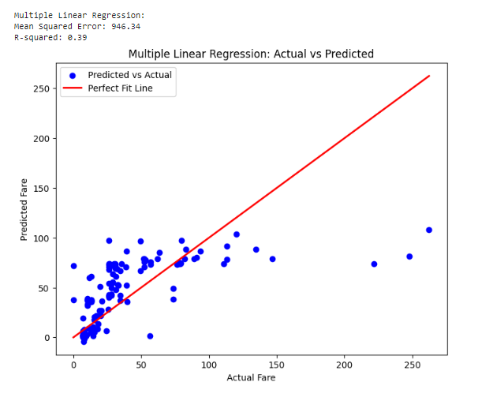
Linear Regression Project
Multiple Linear Regression: Actual vs. Predicted Fare
An MSE of 946.34 shows a large gap between predictions and actual values, while an R-squared of 0.39 indicates ‘Age,’ ‘pclass,’ ‘sibSp,’ and ‘parch’ partly predict ‘Fare,’ with other factors still influential.
Compared to simple regression, multiple regression improves R-squared and lowers MSE, but errors remain high, showing room for improvement.

Slide 22
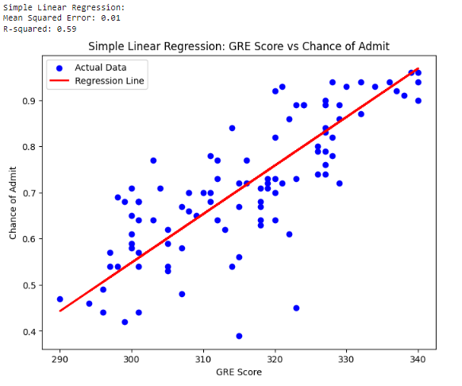
Linear Regression Project
Simple Linear Regression: GRE Score vs. Chance of Admit
The MSE of 0.01 indicates close predicted and actual values, suggesting fairly accurate predictions. An R-squared of 59% shows ‘GRE Score’ explains 59% of the variance in ‘Chance of Admit,’ with other factors accounting for the remaining 41%.

Slide 23
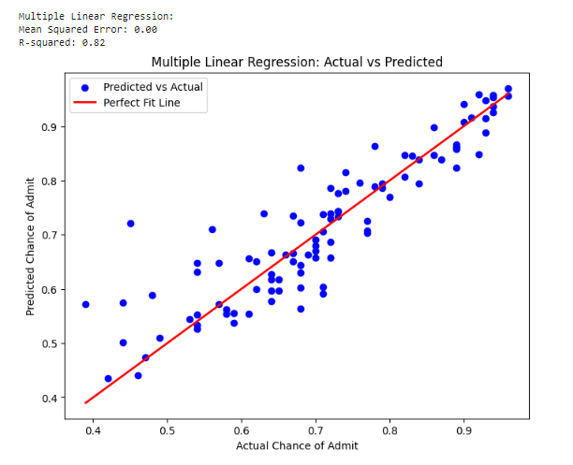
Linear Regression Project
Multiple Linear Regression: Actual vs. Predicted Admit
The MSE of 0.0 shows predicted values are extremely close to actual values. An R-squared of 0.82 indicates that ‘GRE Score,’ ‘TOEFL Score,’ ‘University Rating,’ ‘SOP,’ ‘LOR,’ ‘CGPA,’ and ‘Research’ explain 82% of the variance in ‘Chance of Admit,’ outperforming ‘GRE Score’ alone.
To conclude, Multiple Linear Regression outperforms Simple Linear Regression, as it leads to a lower MSE and a higher R squared.

Slide 24
print("the end")

